Slide 1
Software Engineering
Contact Management System
Group members :
Dhananjay Patel(2868708)
Jaishil Patel(2870762)

Slide 2
Table of Contents
Introduction
Major Requirements
Architecture Design
Implementation
Results
Conclusion

Slide 3
Introduction
The “Contact Management System” has been developed to override the problems prevailing in the practicing manual system. This software is supported to eliminate and in some cases reduce the hardships faced by this existing system.
This GUI based Contact Management system provides the simplest management of contact details. In short, this projects mainly focus on CRUD. There’s an external database connection file used in this mini project to save user’s data permanently.

Slide 4
Major Requirements
Contact Management:
• Requirement: Users can add new contacts.
• Requirement: Users can edit existing contact details.
• Requirement: Users can delete contacts.
Search and Filter:
• Requirement: Users can search for contacts by name or other criteria.
Contact Details:
• Users should be able to view and manage detailed information for each contact
User Settings:
• Users should be able to customize their profile information, including name, email and contact information

Slide 5
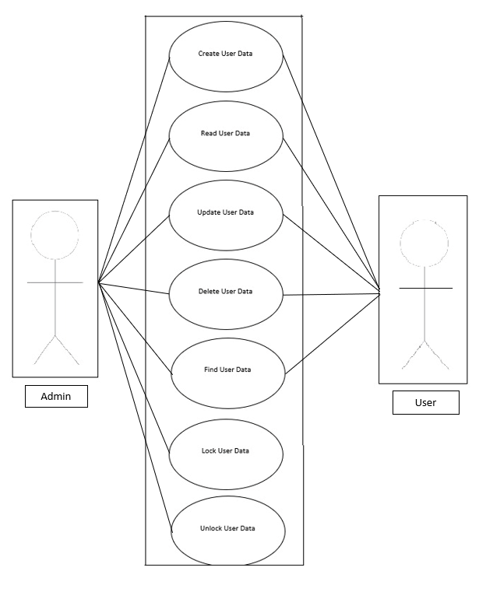
Use Case
A contact management system (CMS) is a software application designed to help businesses and individuals organize and manage their contacts efficiently. Here is a use case diagram for a contact management system

Slide 6
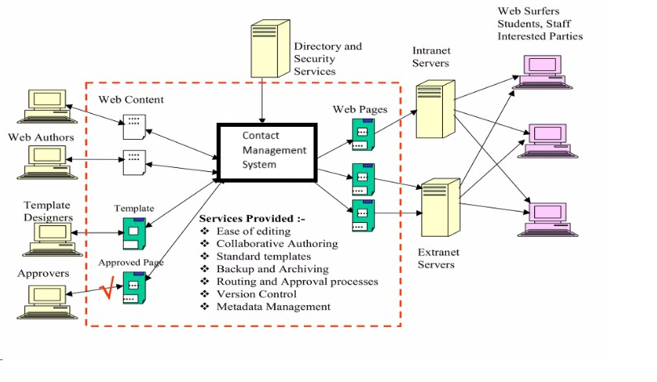
Architecture Design

Slide 7
Implementation decision
Platform : Notepad++
Programming language : Python
Library : Python libraries
Database : MySQL
Server : MySQL Server
Device : Desktop Only

Slide 8
Testing and Result
Test ID | Input | Output | Status
CMS_TC001 | Create a new Contact | Successfully created | Pass
CMS_TC002 | Update Contact Details | User update their contact successfully | Pass
CMS_TC003 | Delete Contact Details | User delete their contact successfully | Pass
CMS_TC004 | Search Contact Detail | User able to search contact | Pass

Slide 9
Conclusion
A Contact Management System (CMS) is a valuable tool for individuals and businesses to organize and maintain their contacts efficiently. It enhance communication, Improved productivity, Data security and also it is helps in organizing contacts systematically.
During the project we learned is a crucial aspect of project management that helps teams reflect on their experiences and improve future projects

